Slide 1



SEVENTY EIGHT MARKETING PLAN

Slide 2
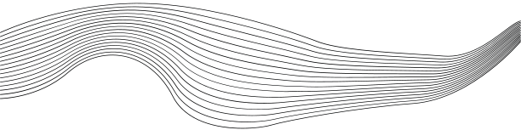
CONTENT
01
OUR TEAM
10
STP
02
03
BRAND OVERVIEW
11
12
PERSONA
VISION AND MISSION
COMPETITOR RESEARCH
04
BUSINESS MODEL CANVA
13
GOALS AND OBJECTIVES
SEO
05
USP
14
06
7PS
15
OUR WEBSITE
07
CHANNELS
16
17
SOCIAL MEDIA CONTENT STRATEGY
08
SWOT
ENGAGEMENT STRATEGY
09
TARGET AUDIENCE ANALYSIS

Slide 3
CONTENT
18
ADVERTISING STRATEGY
19
ADS MANGER
20
RESULTS
21
RECOMENDATIONS
22
TESTIMONIALS

Slide 4
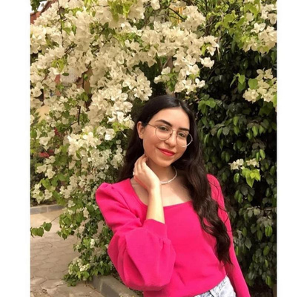
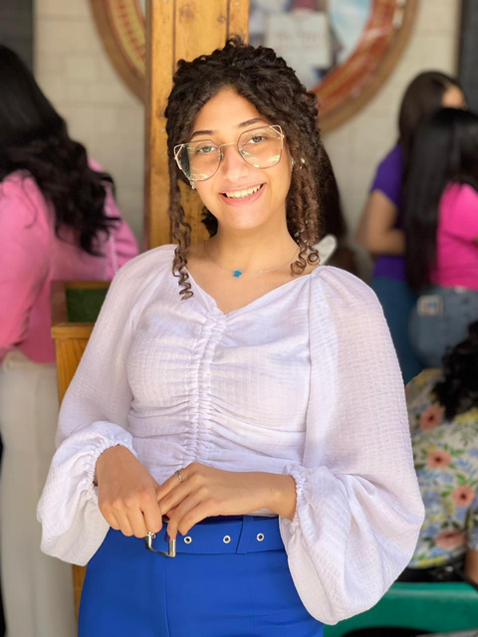
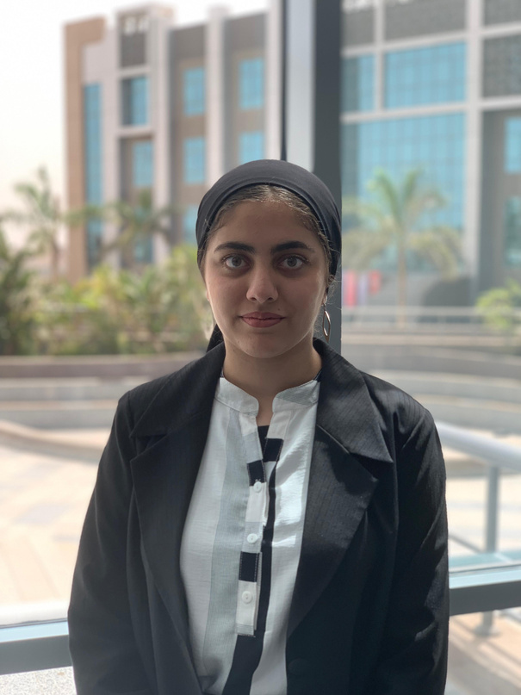
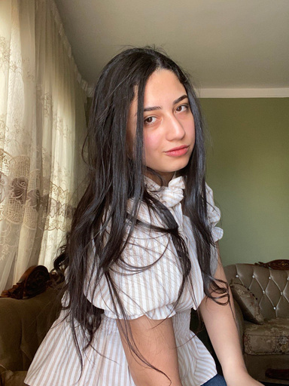
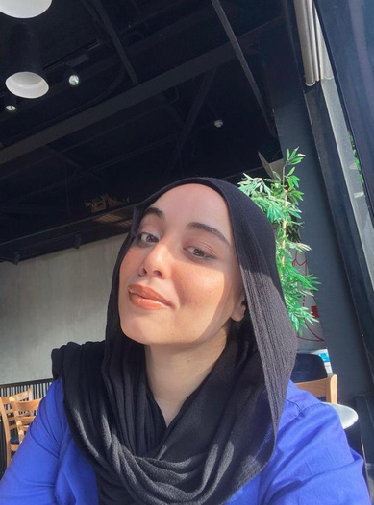

OUR TEAM
Martina Raaft
Mariam Sameh
Nouran Hany
Nada Mostafa
Rawan Samy

Slide 5

BRAND OVERVIEW
Seventy8ight is a brand that caters to fashion, lifestyle, and creative culture
it offers products like T-shirts, hoodies, sweatpants, shorts, and more fashionable clothing.

Slide 6
logo & Slogan
where style,
meets the quality

Slide 7

VISION AND MISSION
To become Egypt's leading youth fashion brand, known for combining high-quality, trendy designs with affordability, and creating a vibrant community where young people can express their unique style with confidence.
Vision
Our mission is to offer high-quality, stylish clothing that resonates with the youth of Egypt. We are committed to providing exceptional customer experiences both online and offline, fostering a sense of individuality through our unique designs, and contributing to the fashion industry with innovative and accessible fashion solutions.
Mission

Slide 8








Key Partners
Customer Relationships
Key Activities
Channels
Customer Segments
suppliers of fabrics and materials.
shipping and delivery companies.
Social media influencers for collaborations
TikTok and Instagram for online sales and promotion
Physical store in 6th of October
City, Egypt
online store via website and social media apps like tiktok and Instagram.
Social media marketing and
influencer collaborations
Word of mouth and in-store
promotions
Online campaigns through
Facebook and Instagram ads
Primary: Young men (ages 18-24),students, early professionals ,active on social media
Secondary: Teen boys (ages
13-17), fashion-conscious and looking for trendy, comfortable wear
Tertiary: Men (ages 35-44), interested in casual, youthful fashion
Engaging and personalized
interactions through social media
(TikTok, Instagram)
Building brand loyalty through-limited-edition collections and exclusive drops
Offering customer support and service in-store and via online platforms
Utilizing social media trends feedback to adjust product
offerings
Designing and producing trendy streetwear
Managing social media presence and influencer collaborations
Online and offline customer
service management
Marketing and promotional
campaigns
Stock management for both exclusive drops and regular items
Enhancing customer experience
in-store and online
Key Resources
Value Proportions
trendy designs that appeal to teens .
Seamless online and offline
shopping experience.
high quality and Affordable fashion accessible to Egypt's B-class market Exclusive, limited-edition drops creating a sense of urgency and uniqueness.
innovative designs and a design team .
inventory of raw materials (fabrics, printing).
Online and offline sales channels
Physical store in 6th of October
City
Influencer and brand
ambassador network
Cost Structure
Revenue Streams
production costs ( fabrics, printing)
marketing cost ( ads, influencer partnerships).
Rent and utilities for the physical
store
Shipping and logistics for
delivering online orders
Direct sales from the physical
store
Online sales via TikTok and Instagram DMs
Business Model Canvas

Slide 9
USP
Affordable Streetwear: The brand provides trendy and stylish clothing at an affordable price point, making street fashion accessible to Egypt’s B-class market.
Urban Culture & Style: Seventy8ight taps into Cairo’s vibrant street culture and offers designs that resonate with fashion-forward individuals.
Exclusive Drops: Seventy8ight creates a sense of urgency and uniqueness with limited-edition collections and drops, appealing to those who want exclusive pieces.
Locally-Inspired: By infusing local flavor into global streetwear trends, Seventy8ight stands out as a brand that reflects Egyptian culture while staying connected to worldwide fashion movements.

Slide 10
7PS
2. Price
Seventy8ight operates in the affordable price range, targeting the B-class market. The pricing strategy is competitive, designed to offer value for money while maintaining high-quality fabrics and trendy designs. Seasonal promotions, discounts, and exclusive offers (e.g., flash sales) help to further attract price-sensitive customers.
4. Promotion: Promotion involves how Seventy8ight markets its products and brand. This could include social media marketing, influencer collaborations, promotions, and advertising campaigns. Their Instagram presence is a crucial part of this, allowing them to showcase products, engage with customers, and create a brand narrative
6. Process: This refers to the systems and processes that deliver the product to the customer. It includes everything from order processing, shipping, and delivery to the user experience on their social media platforms. Seventy8ight should focus on making these processes seamless and efficient to enhance customer satisfaction.
1. Product
Seventy8ight offers trendy, urban-inspired streetwear with bold, unique designs that reflect Cairo’s vibrant youth culture. The product range includes T-shirts, hoodies, jackets, specifically tailored for a young, fashion-forward audience. The focus is on affordability without compromising on style or quality, with limited-edition drops to create exclusivity.
5. People: The people aspect covers those who interact with customers, from the brand's customer service team to sales personnel. For Seventy8ight, this could involve how they engage with followers on social media, the responsiveness of customer service, and the brand's overall approach to customer interactions. Ensuring a positive and personalized customer experience is key.
3.Place: Seventy8ight sells primarily through an offline store, and secondary online orders through Instagram and TikTok DMs.
This refers to where and how the products are sold. Seventy8ight seems to utilize online platforms, particularly Instagram, for marketing and potentially for direct sales. This choice suggests a strategy focusing on digital channels to reach a broader audience, potentially complemented by a physical store or pop-up events
7.Physical Evidence: Physical evidence involves the tangible aspects that help customers connect with the brand, such as packaging, branding materials, and the overall aesthetic of their online presence. For Seventy8ight, this could mean stylish and cohesive packaging, a visually appealing Instagram feed, and any other physical touchpoints that reinforce the brand's image and values.

Slide 11


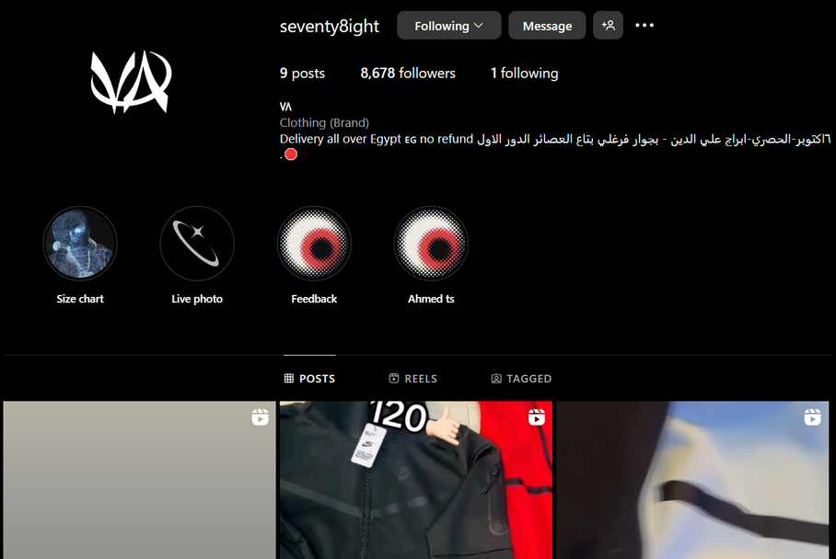
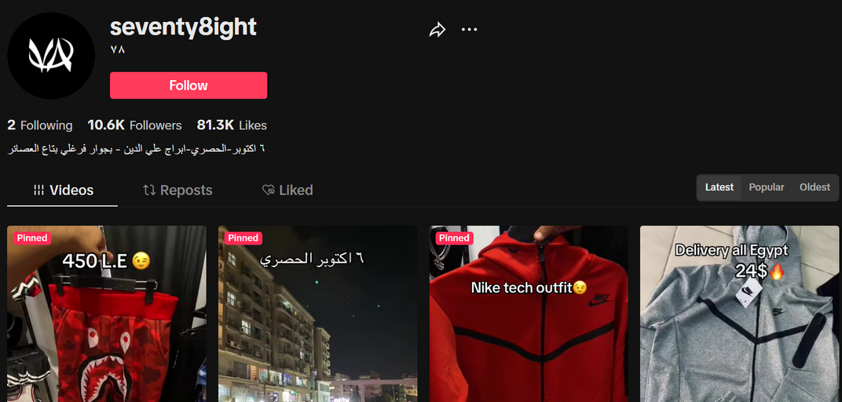
CHANNELS

Slide 12
SWOT
Strength: High quality materials, unique and trendy designs, growing social media presence.
Weakness:poor customer service response time ,unclear offline store location.
Opportunities:Growing youth fashion market in Egypt, potential to expand the brand to other cities, opportunities to collaborate with influencers.
Threats:High competition from other local and international brands, potential economic downturn affecting consumer spending.

Slide 13
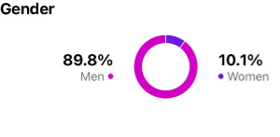
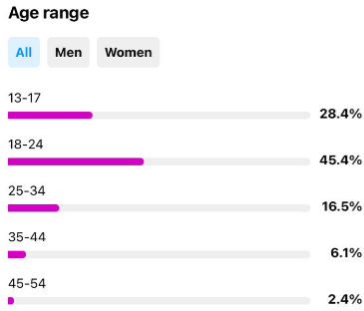
TARGET AUDIENCE ANALYSIS
Demographics: Ages 13-54, predominantly males and females, with an interest in fashion, design, or streetwear.
Location: People who live in Cairo and nearby governments.
Interests: Fashion, music, nightlife, art, and creativity.
Behavior: They engage with visual-driven content, look for unique, trendy pieces, and often follow influencers and brands that match their style.

Slide 14
STP
Segmentation
Targeting
postiosing
Demographic: - Gender: Primarily men (90%) - Age groups: 13-17 (30%), 18-24 (45%), 35-44 (6.1%), 45+ (1%) - Income: Likely medium-income youth and young professionals - Psychographic: - Interests: Youth fashion, casual wear, streetwear trends - Lifestyle: Social media-active, fashion-conscious, values unique designs and quality - Behavioral: - Purchase behavior: Online shoppers, looking for youthful, trendy designs - Brand loyalty: Engages with brands on TikTok and Instagram, responsive to social media trends
Primary Target: - Men aged 18-24 (45% of your audience) – Focus on students, early career professionals who are fashion-conscious and active on social media. - Secondary Target: - Teen boys aged 13-17 (30%) – Appeal to their need for trendy, comfortable fashion for school and social settings. - Tertiary Target: - Men aged 35-44 (6.1%) – A smaller but notable group, likely interested in comfortable and youthful fashion for casual outings.
Positioning Statement: "For fashion-forward young men who value both style and comfort, Seventy8ight Store offers high-quality, trendy t-shirts and pants designed to keep up with your dynamic lifestyle. With modern youthful designs and superior fabrics, we bring the latest fashion to your wardrobe at affordable prices." - Differentiation: - Youthful, modern designs that appeal to trendy, style-conscious men. - High-quality materials that provide both comfort and durability. - Strong online presence and social media engagement, making fashion accessible and relevant to a tech-savvy audience.

Slide 15

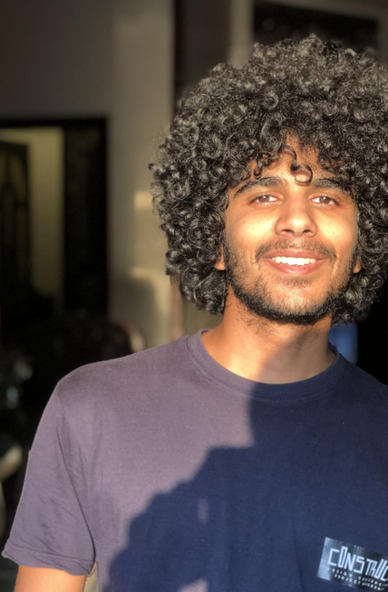

Values
BUYER PERSONA
Interests
Ahmed values self-expression through fashion, especially in how he presents himself at university and social events.
He prefers high-quality streetwear that combines comfort, durability, and affordability.
Ahmed looks for local brands that can give him a unique style without being too expensive.
Streetwear fashion, sneakers, and design
Architecture, urban design, and graffiti art
Music (hip-hop, rap) and street culture
Video games and online communities
Following influencers and fashion-forward peers for style inspiration
MALE
AHMED
Digital Behavior
Challenges & Pain Points
Active daily on Instagram and TikTok, primarily following fashion influencers, streetwear brands, and Egyptian cultural figures.
Engages with content from streetwear brands through Instagram posts, stories, and videos.
Shops online via Instagram or Facebook Marketplace, often looking for exclusive drops or new collections.
Limited Local Options: He often finds it challenging to find trendy streetwear options in Egypt that are affordable yet good quality.
Pricing: While he values fashion, he's sensitive to high prices and prefers discounts or promotions.
Age: 22
Gender: Male
Location: Cairo, Egypt (lives in october City)
Occupation: University student
Income Level: Middle to upper-middle class
Education: Bachelor’s degree in Architecture

Slide 16
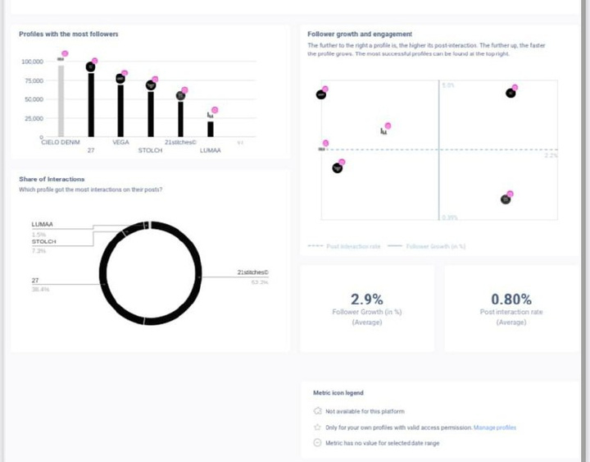
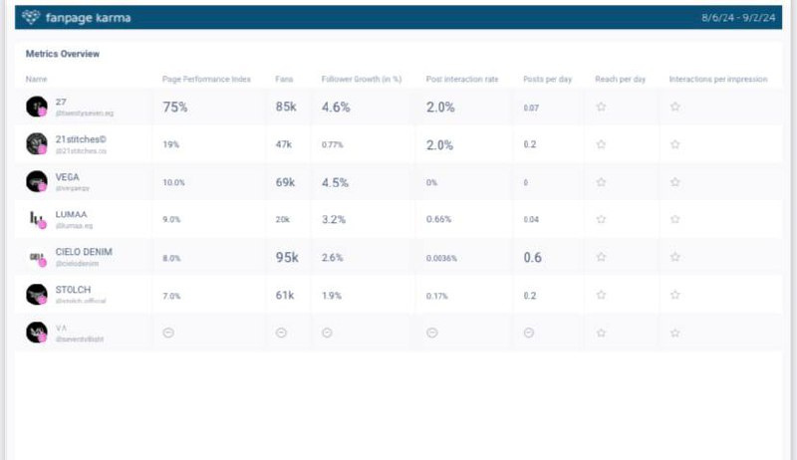
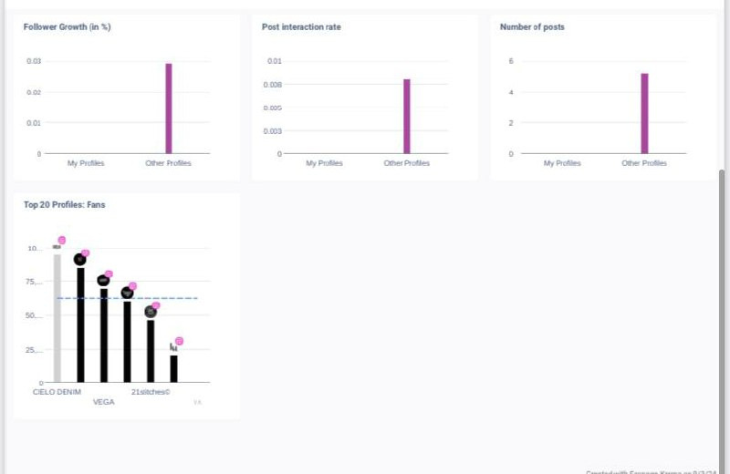
COMPETITOR RESEARCH

Slide 17
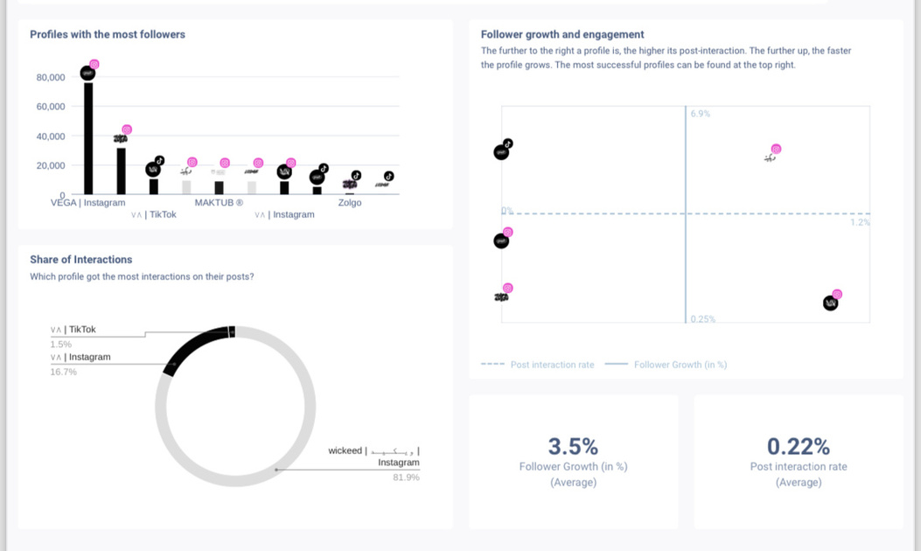
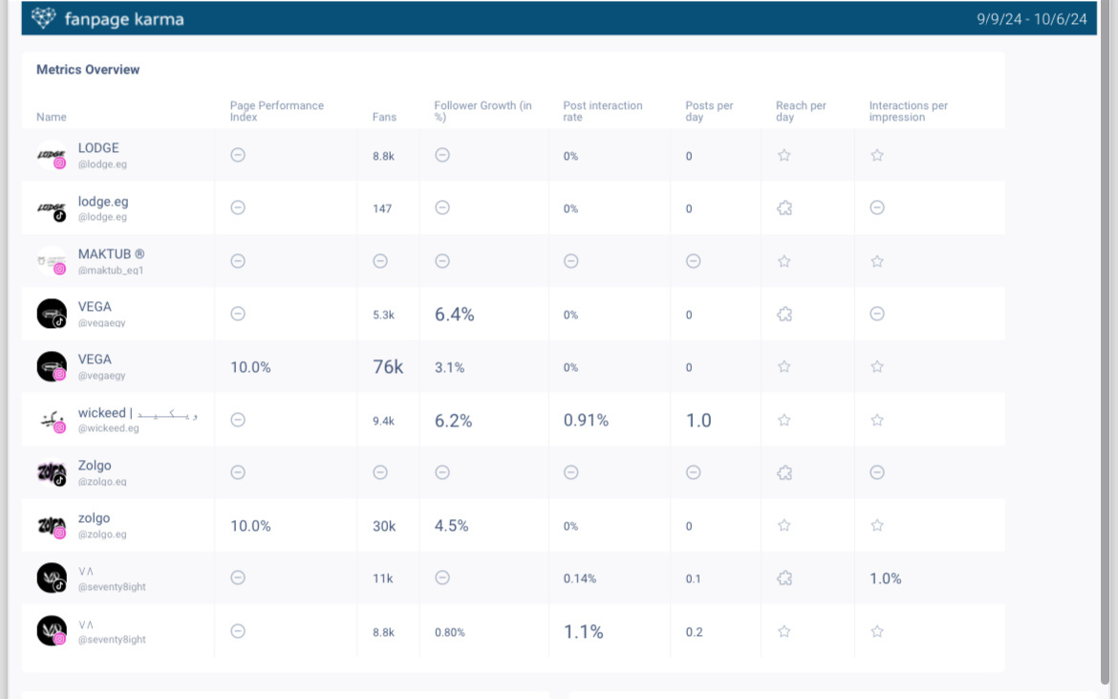
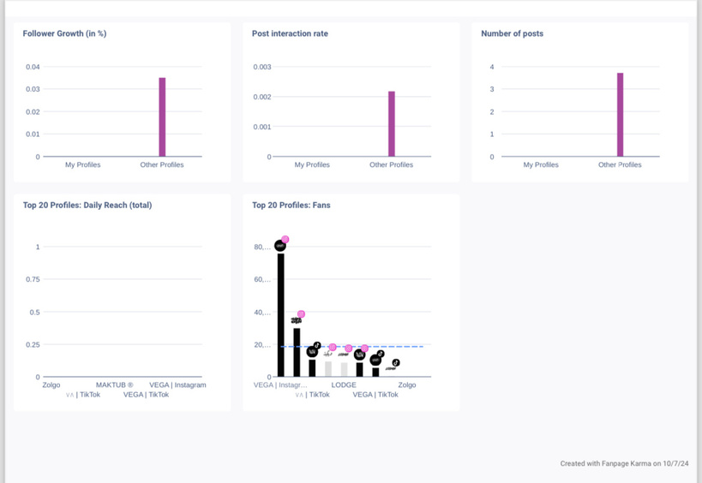
COMPETITOR RESEARCH

Slide 18
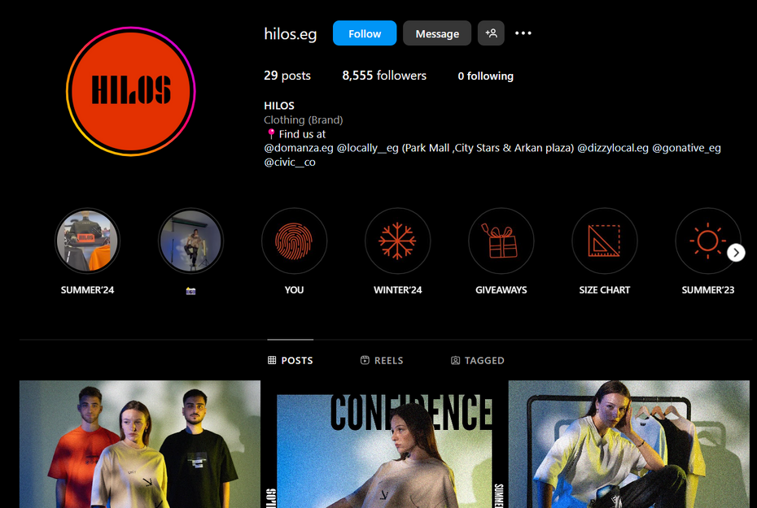
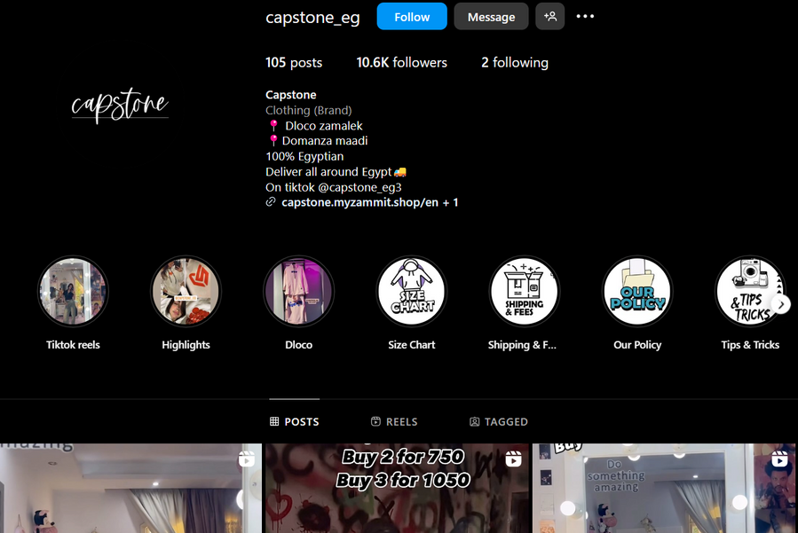
VISUAL AND ACTUAL COMPETITOR ANALYSIS ON SOCIAL MEDIA PLATFORMS
They have higher engagement.
Their advantage that they have a website.

Slide 19
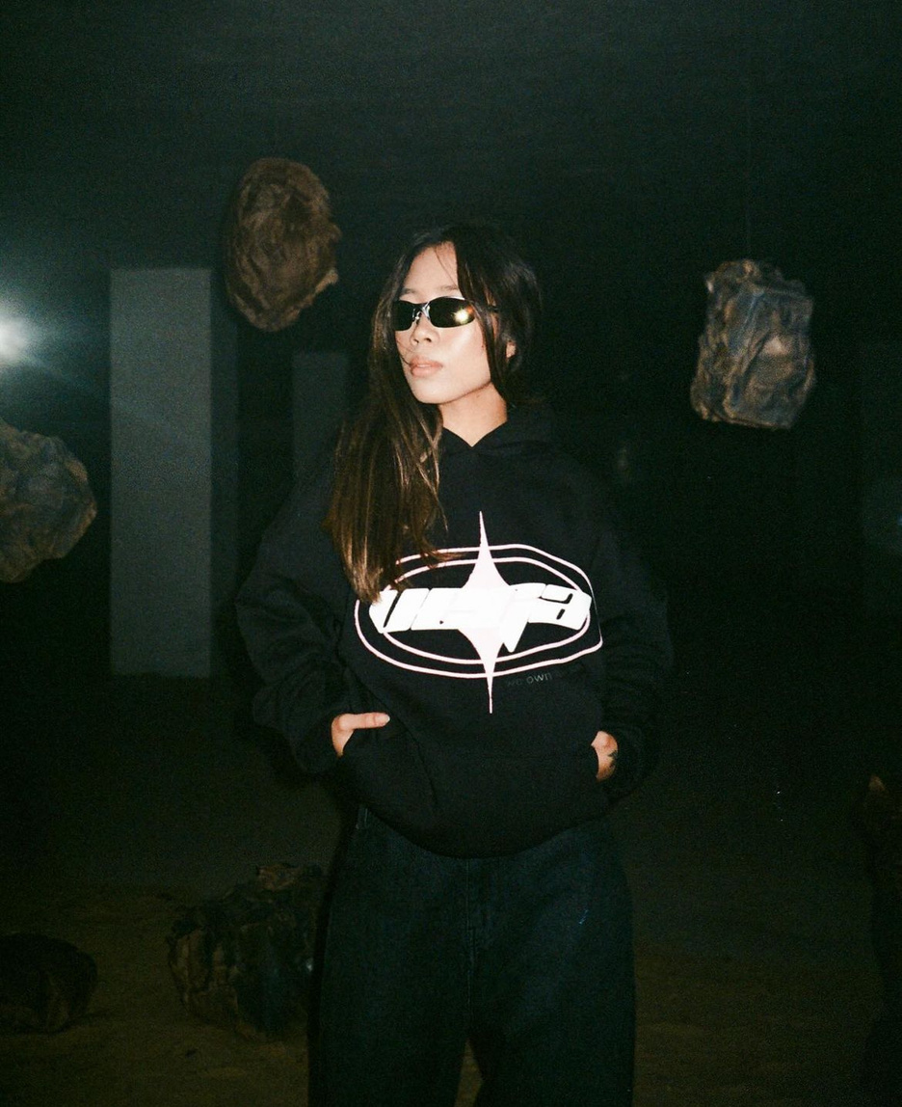
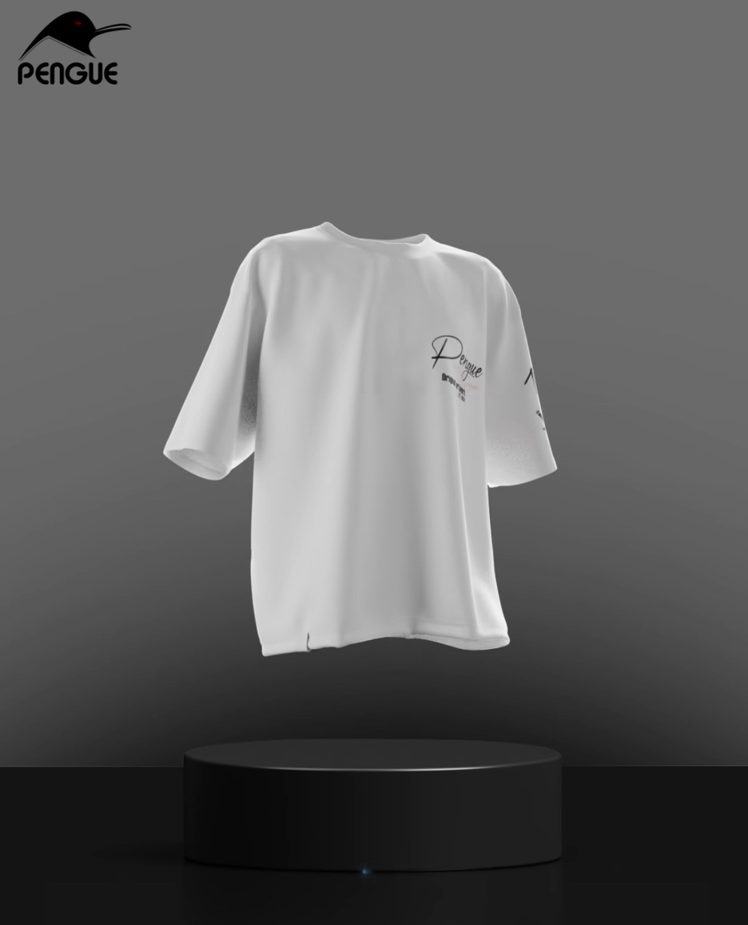
VISUAL AND ACTUAL COMPETITOR ANALYSIS ON SOCIAL MEDIA PLATFORMS
They use themed presentations, like artistic or detailed designs, to appeal to specific audiences
Some competitors adopt a clean, minimalist style, using high-quality or 3D-rendered images to create a polished and professional look

Slide 20
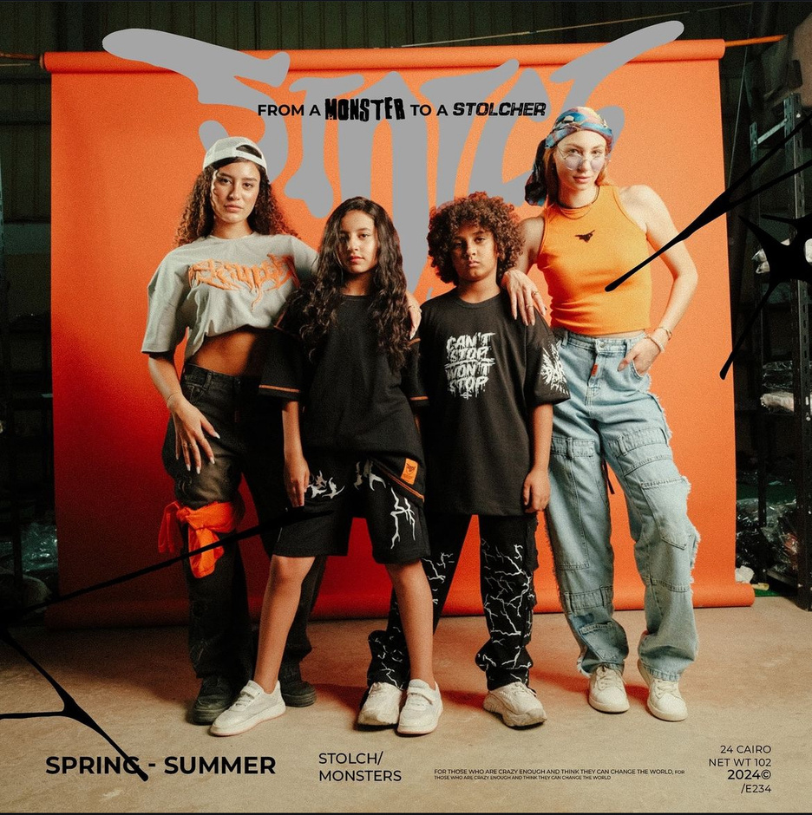
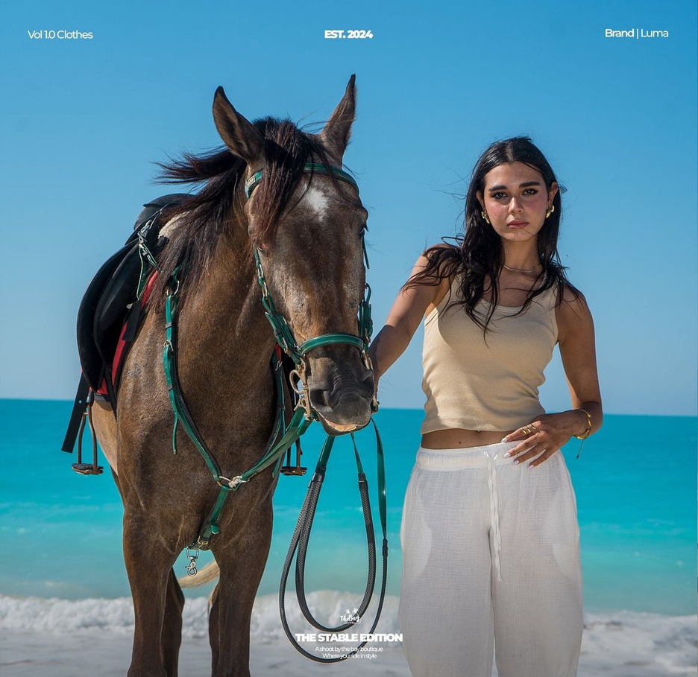
VISUAL AND ACTUAL COMPETITOR ANALYSIS ON SOCIAL MEDIA PLATFORMS
Some competitors use darker palettes for a casual streetwear feel
while others mix pastels and neutrals for a versatile, contemporary vibe

Slide 21
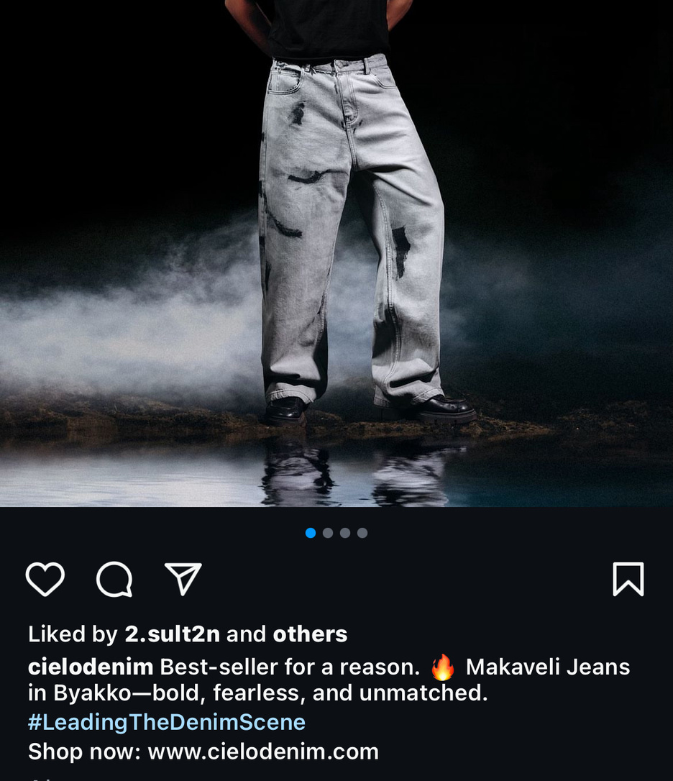
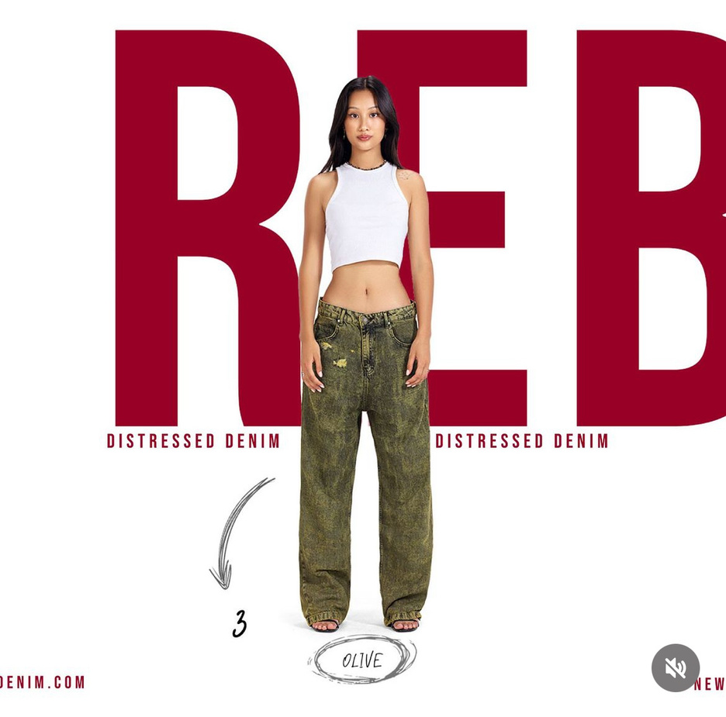
VISUAL AND ACTUAL COMPETITOR ANALYSIS ON SOCIAL MEDIA PLATFORMS
They often use straightforward descriptions, highlighting basic features such as size and colors.
Some competitors emphasize theme-based, personality-driven content to attract niche audiences seeking unique designs.

Slide 22
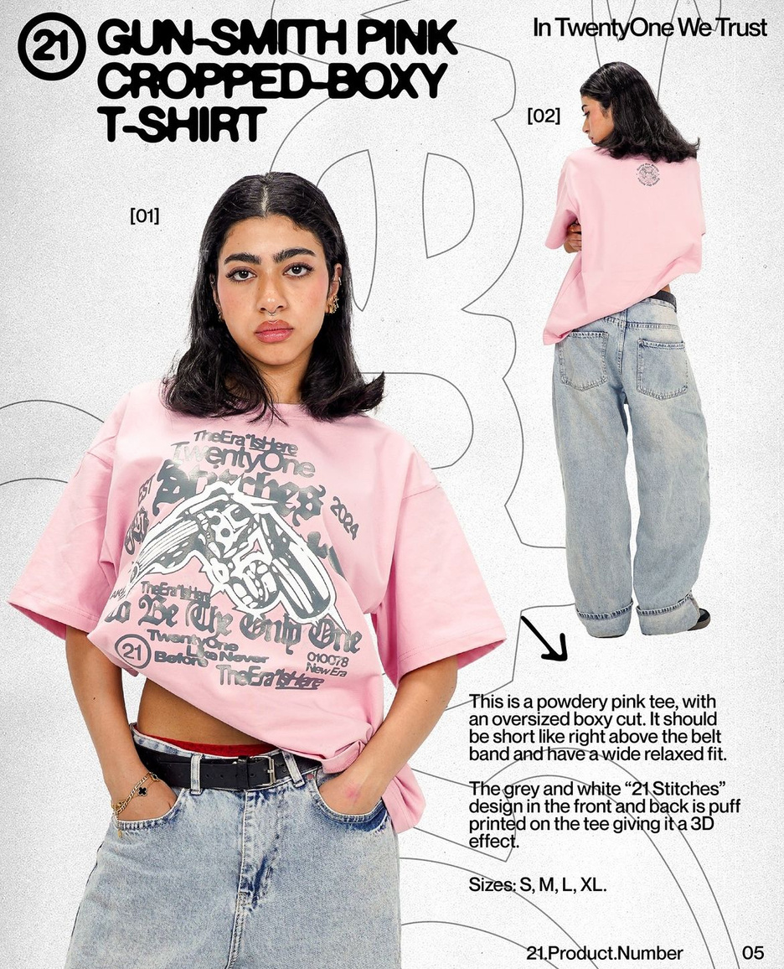
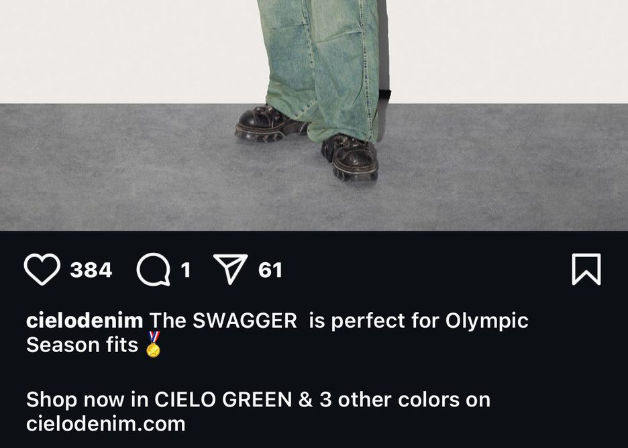
VISUAL AND ACTUAL COMPETITOR ANALYSIS ON SOCIAL MEDIA PLATFORMS
Others use consistent backgrounds and lighting across posts, creating a strong visual identity and reinforcing a premium brand image.
Call to Action: They encourage customers to order

Slide 23
GOALS AND OBJECTIVES
Increase Brand Awareness
Improve customer service
Boost
Engagement
Grow Instagram followers by 10% over each month through organic and paid reach.
Reduce response time to customer inquiries on social media to under 1 hour by the end of the next quarter.
Increase post interaction (likes, comments, shares) by 20% within a month.
Boost sales
Enhance Product Range
Create a
website
Increase online and offline sales by 15% over the next 6 months.
Diversify the clothing collection by introducing new styles, seasonal lines.
It will help increase sales and make it easier and faster for customers to purchase.

Slide 24
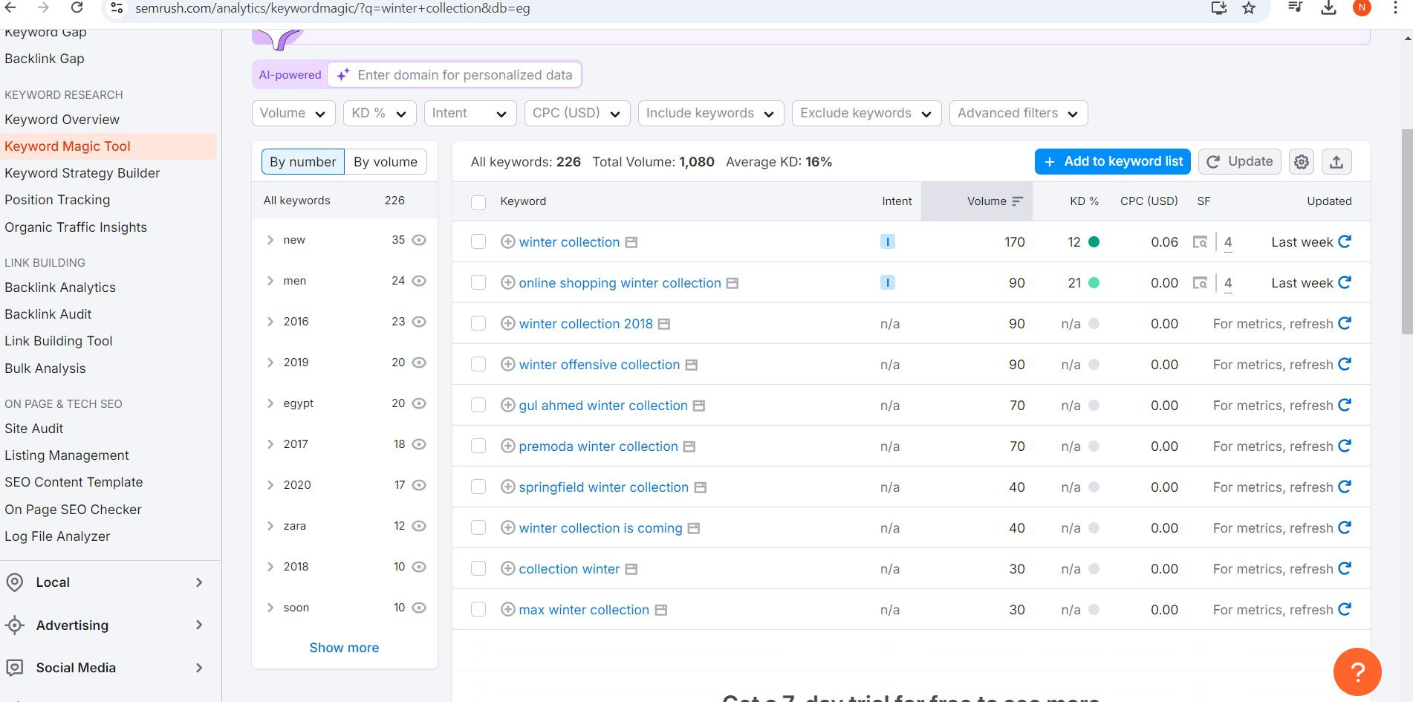
SEO
We utilize SEMrush’s SEO keywords to optimize our content and enhance our website development.

Slide 25
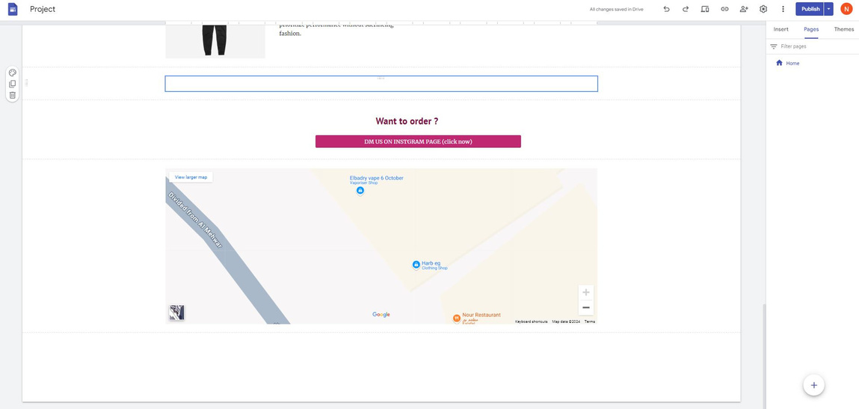
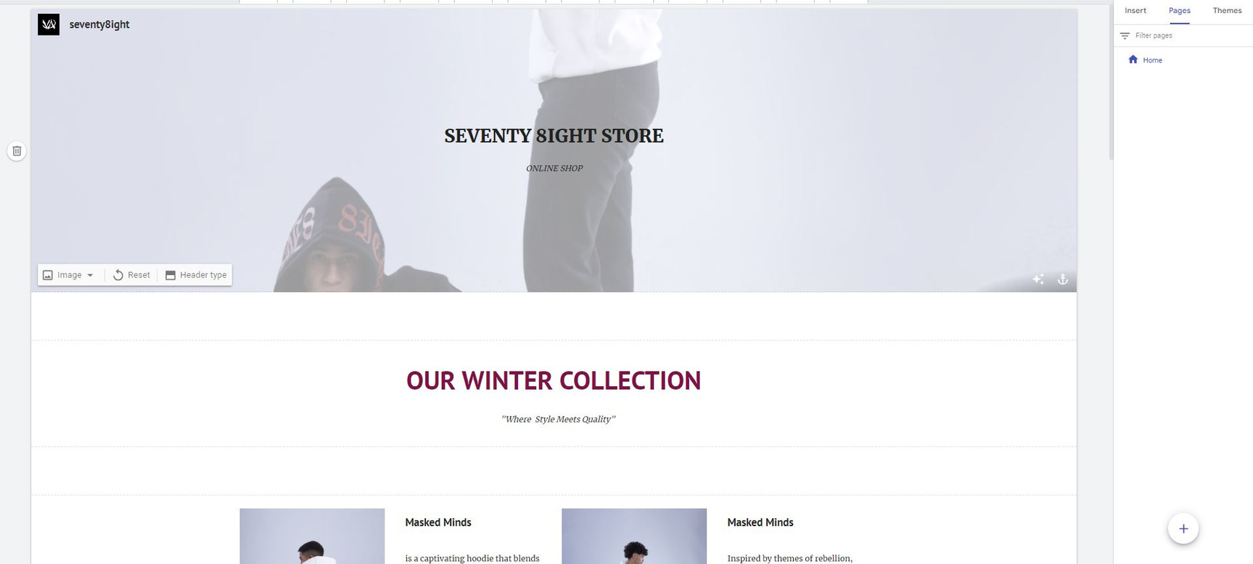
NEW WEBSITE
we put our store location and instgram hyperlink
we create new website on google sites
website link

Slide 26
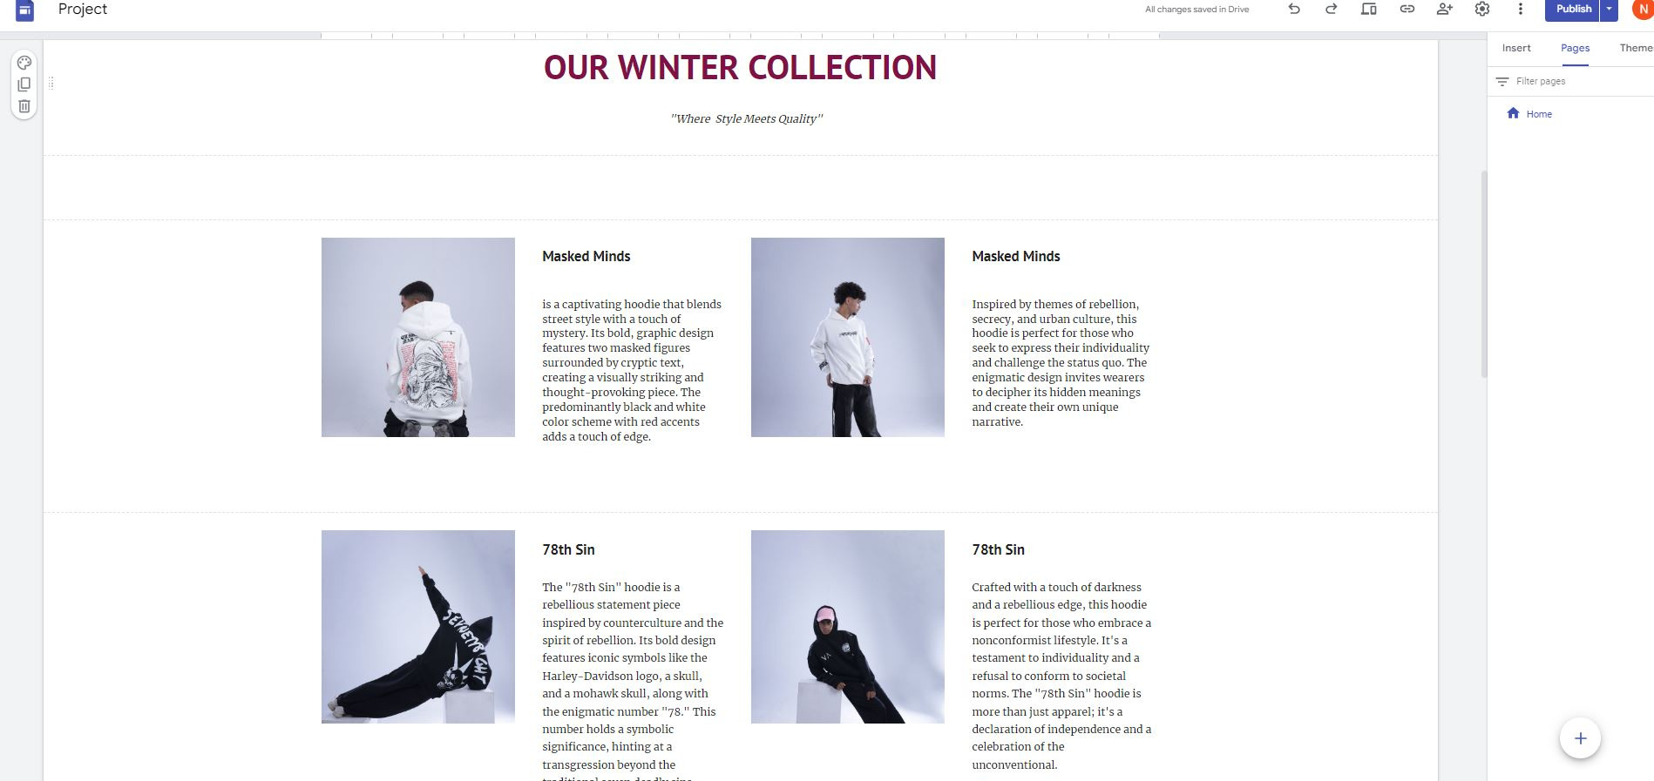
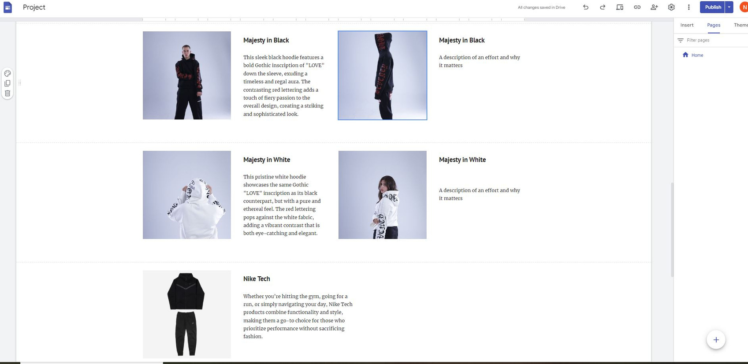
WEBSITE
we name each new item and put a descreption for each one

Slide 27

SOCIAL MEDIA CONTENT STRATEGY

Slide 28

CONTENT MIX
01
02
03
50% PRODUCT SHOWCASES
30% USER-GENERATED CONTENT
20% INTERACTIVE CONTENT
Posts and Reels of products in styled settings. For example, models wearing Seventy8ight apparel in vibrant street locations.
Goal: Build brand awareness and highlight product quality.
Repost content from customers wearing or using Seventy8ight products, tagged stories.
Goal: Build community and trust.
Polls, quizzes, and stories where followers can vote on favorite styles or trends.
Goal: Encourage engagement and interaction.

Slide 29

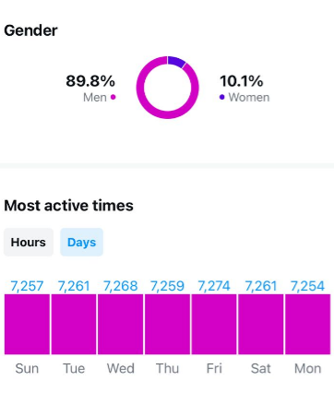
POSTING FREQUENCY
Posts: 2 per week (a mix of product shots, lifestyle imagery, and collaborations).
Stories: 4-5 weekly stories, using polls, countdowns, and UGC to drive interaction.
Reels: 1-3 per week featuring dynamic, short-form videos. These can show outfit transitions, behind-the-scenes shoots, or highlight unique products.

Slide 30
ENGAGEMENT STRATEGY
Interactive Stories: Run weekly polls, quizzes, and Q&As to invite customers to engage. Use Instagram stickers (questions, polls) to directly interact with followers.
Hashtag Strategy: Use a mix of trending and niche hashtags (e.g., #Streetwear, #FashionDaily, #OutfitInspo) and encourage followers to tag their content with a branded hashtag (#Seventy8ightStyle) for repost opportunities.

Slide 31
ADVERTISING STRATEGY
Audience Targeting: Focus on people interested in fashion, streetwear, and design within the target age group (13-54), using detailed targeting for competitors or related brands (e.g., people who follow streetwear pages or fashion bloggers).
Ad Format: Use carousel ads to showcase a collection of products and in-feed video ads to highlight product launches or limited-time promotions.
Goal: Drive traffic to the Instagram page and boost brand awareness.
and it increased by 99.9%

Slide 32
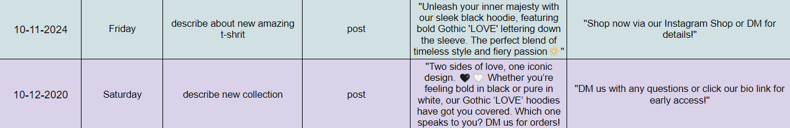
CONTENT CALENDAR

Slide 33
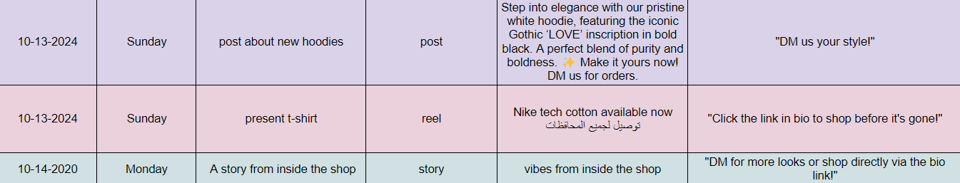
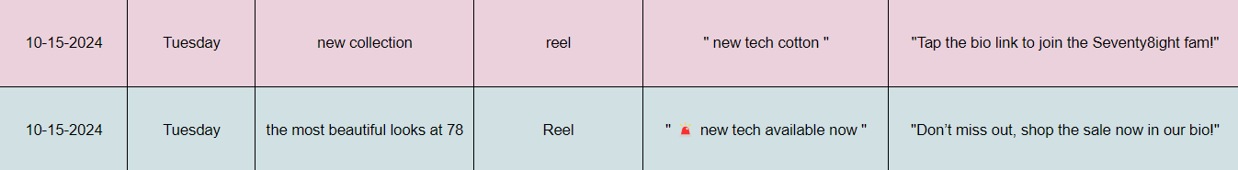
CONTENT CALENDAR

Slide 34
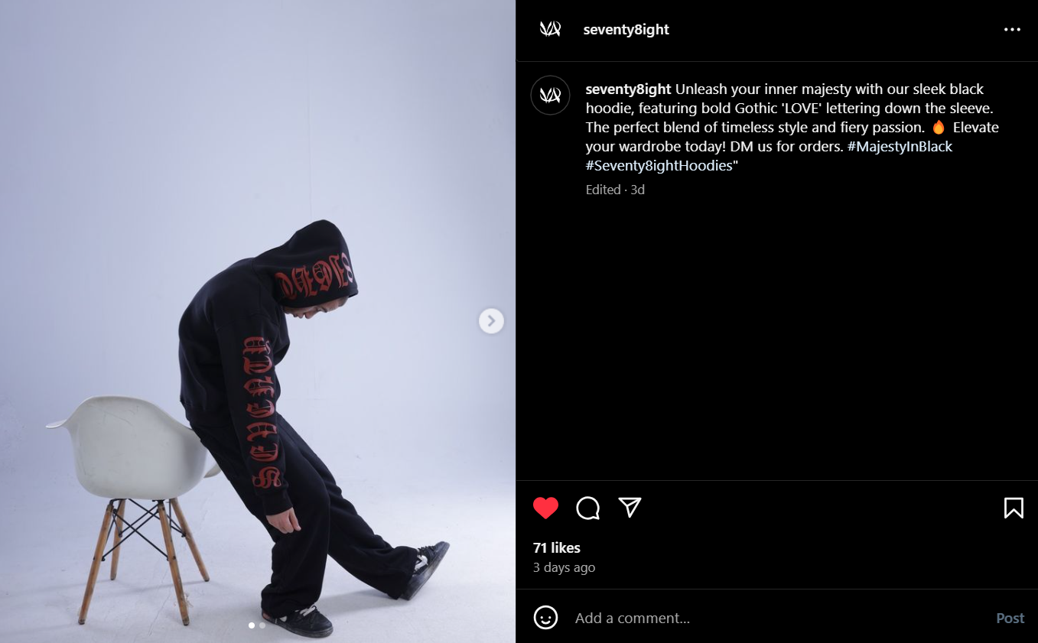
EXAMPLE FORM OUR CONTENT

Slide 35
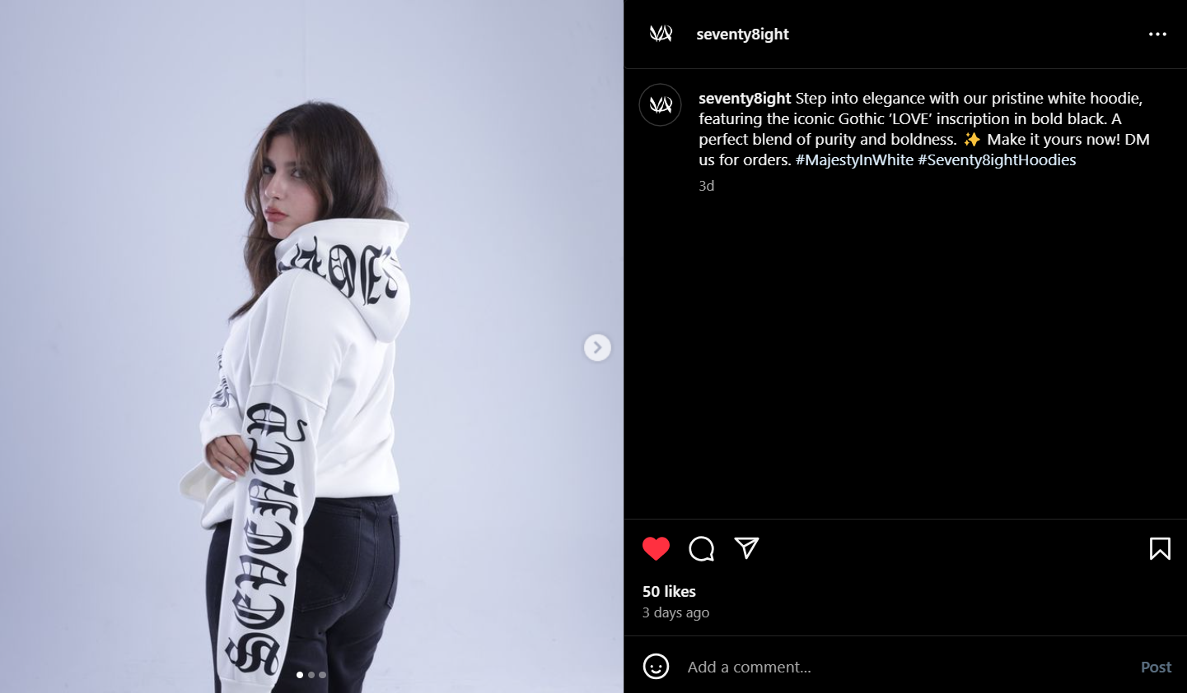
EXAMPLE FORM OUR CONTENT

Slide 36
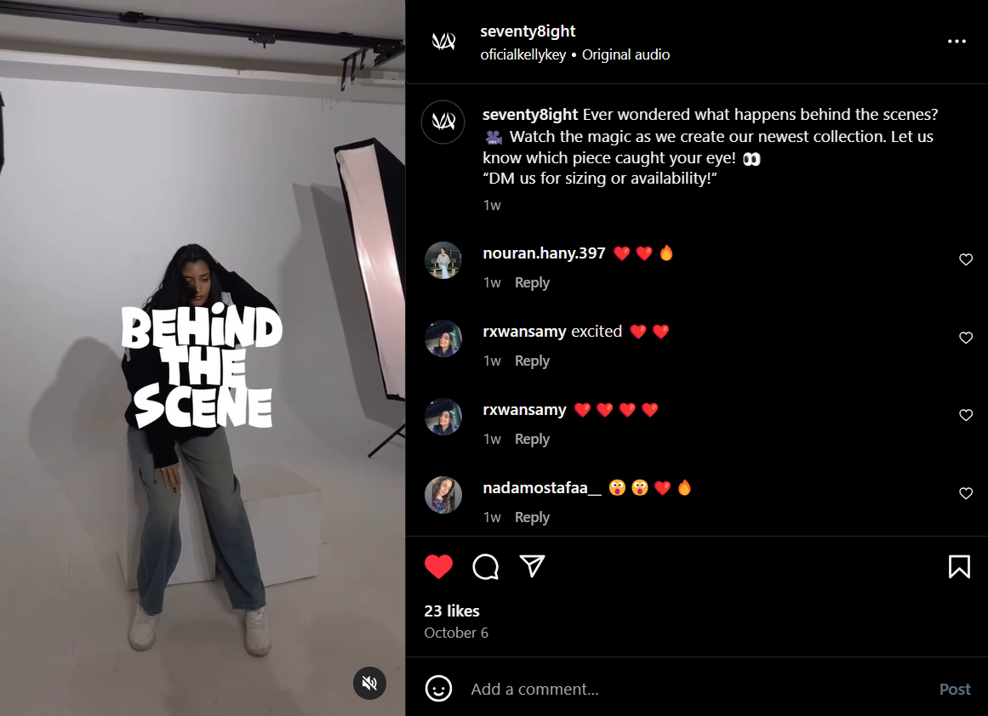
EXAMPLE FORM OUR CONTENT

Slide 37
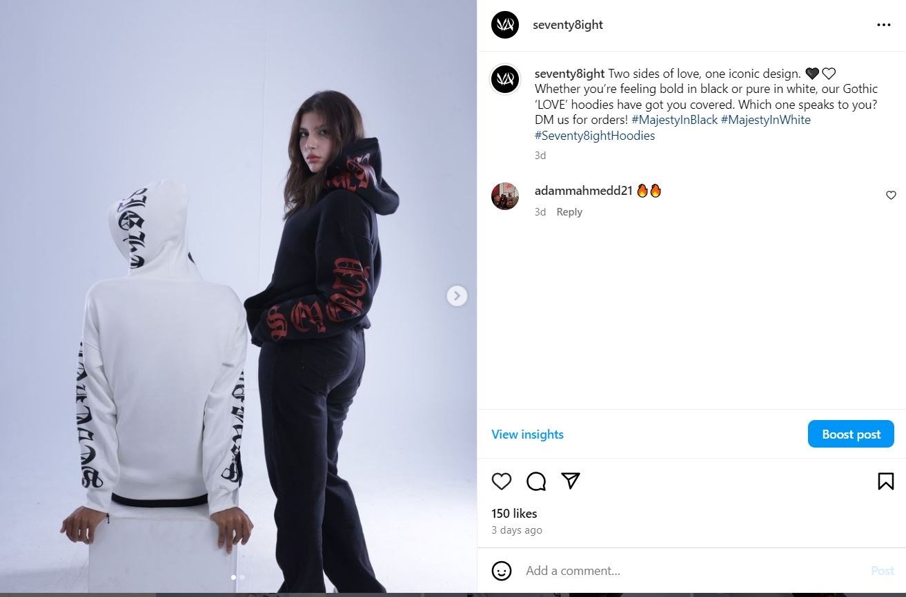
EXAMPLE FORM OUR CONTENT

Slide 38
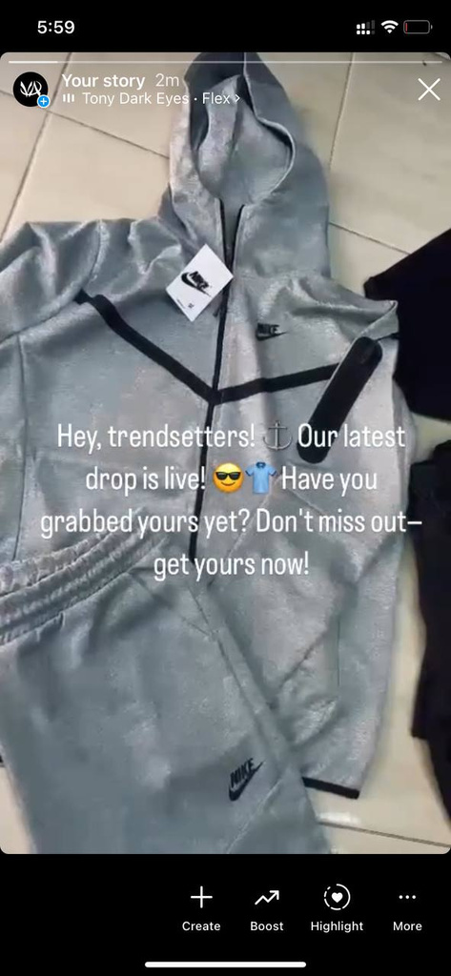
1ST STORY ON INSTAGRAM

Slide 39
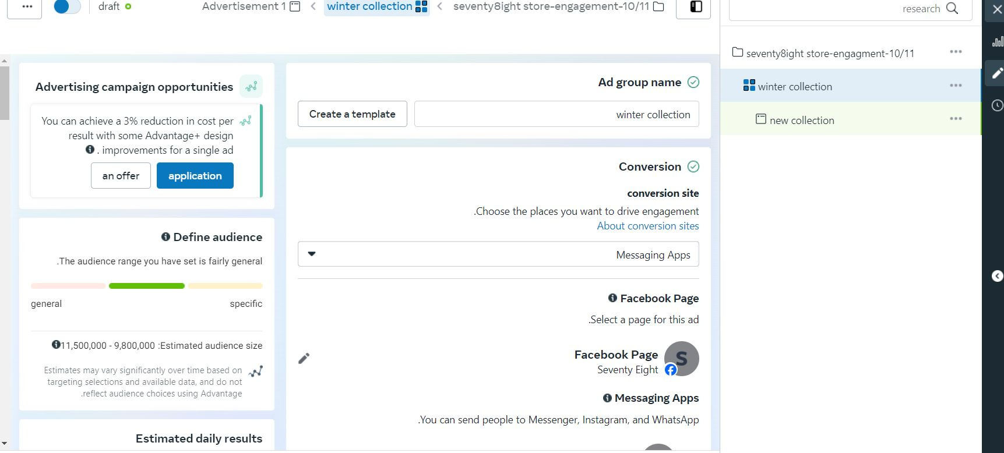
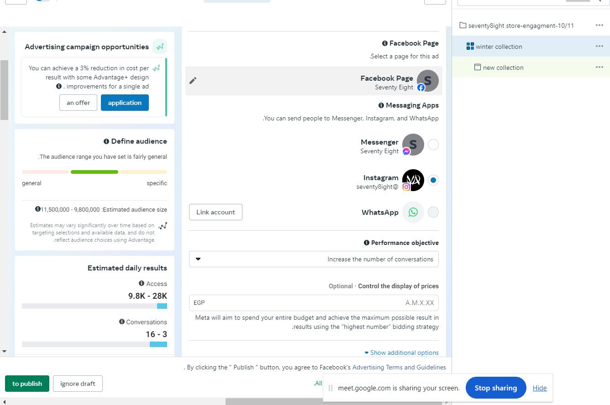
ADS MANAGER
we choose the goal engagment

Slide 40
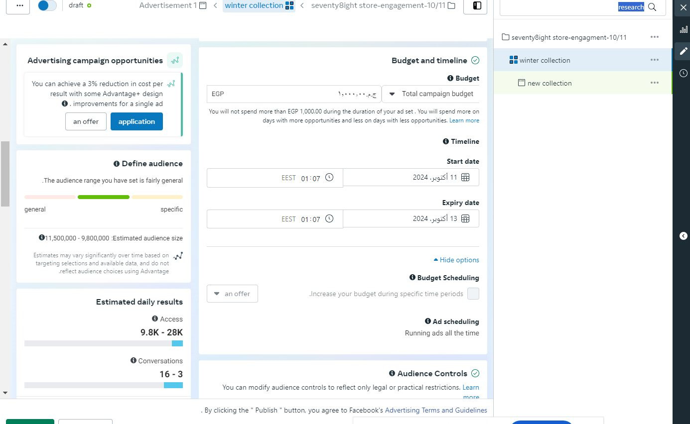
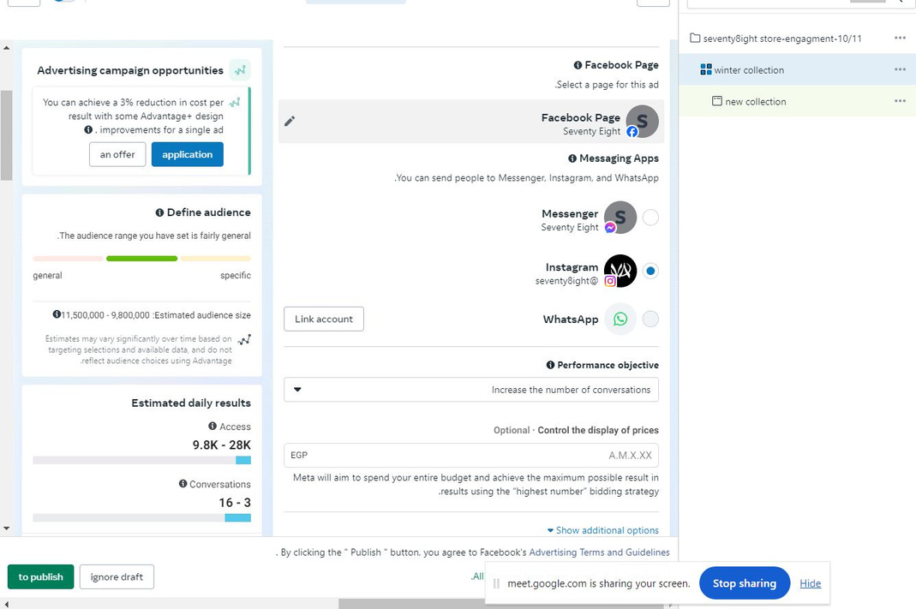
ADS MANAGER
life time budget 4 DAYS

Slide 41
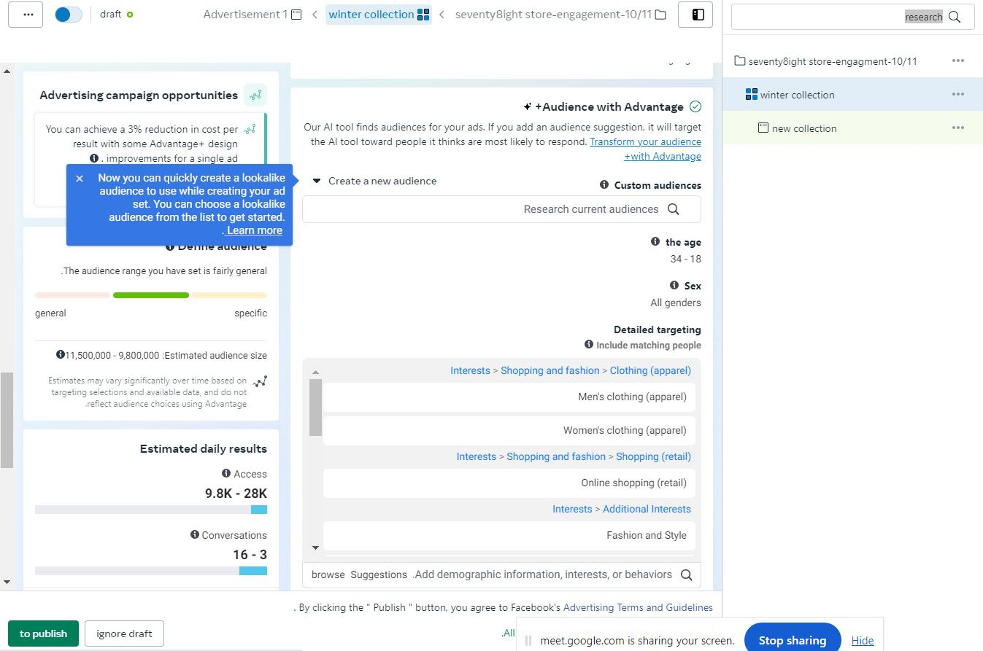
ADS MANAGER
-Age 18 to 34
-INTRESTS ONLINE SHOPPING
FASHION AND STYLE
-LOCATION EGYPT BECAUSE WE DO SHIPPING ALL OVER EGYPT

Slide 42
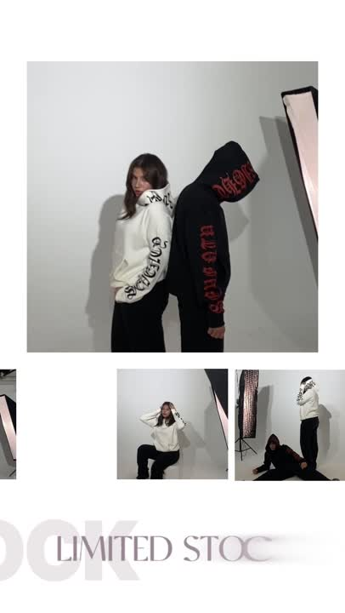
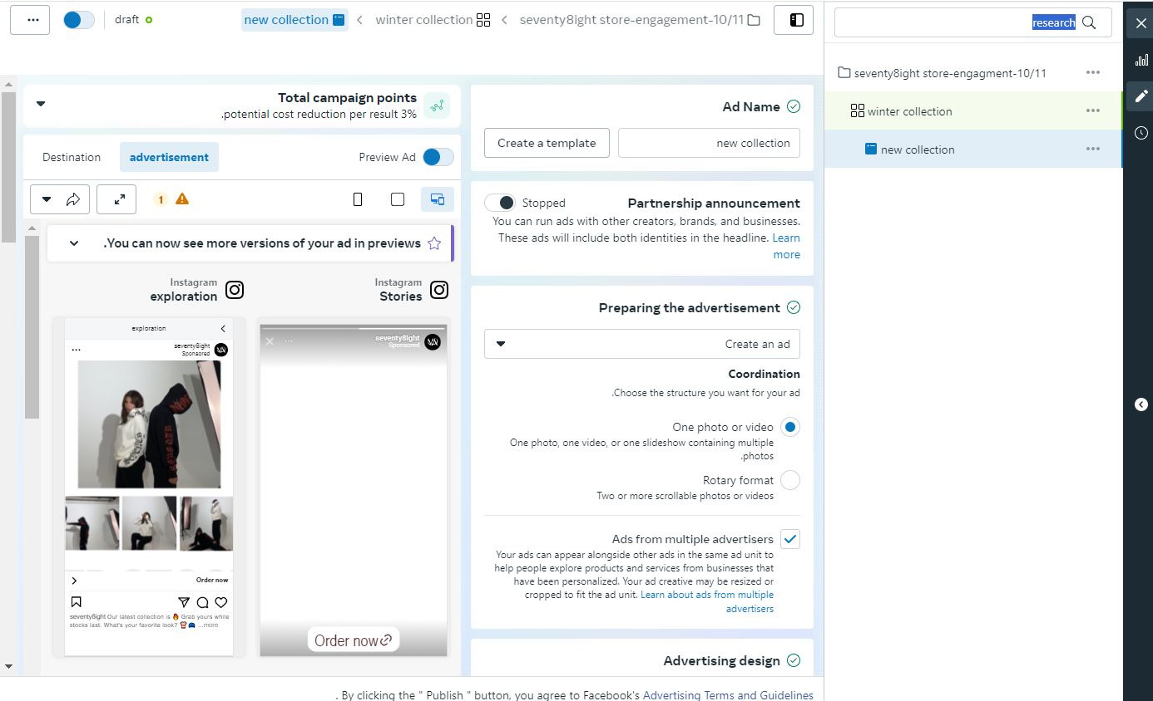
ADS MANAGER
DARK POST REEL THAT HAVE ALL OUR COLLECTION

Slide 43
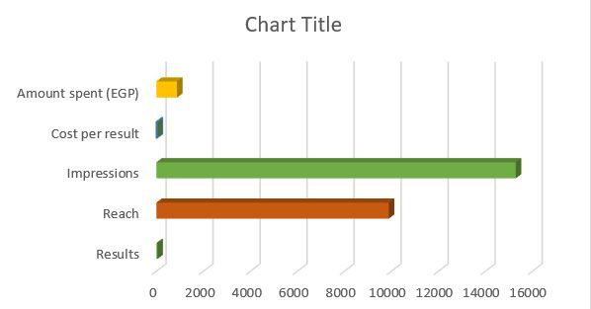
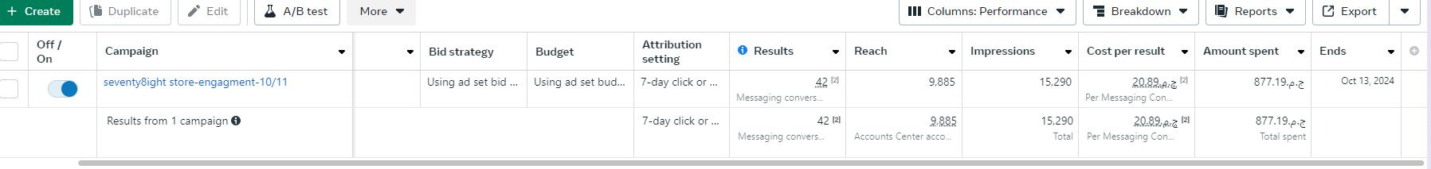
RESULTS
Amount spent :877.19
CPC:20.89
Reach:9885
impressions :15290
messege:42

Slide 44

RESULTS
BEST AGE 18-24

Slide 45

RESULTS
BEST GENDER: MALE

Slide 46

RESULTS
cairo
ALEX
Giza
dakahlya
gharbya
sharqia
best location:Cairo-Alex-Giza

Slide 47

RESULTS
BEST PLACMENT : STORIES

Slide 48


FOLLOWERS
BEFORE
AFTER

Slide 49

RECOMMENDATIONS
We will focus on Cairo, Alexandria and Giza as a primary targeted area and Other governorates as a secondary targeted area.
The top engaged age range is 18 to 24, so it’ll be our primary targeted age group.
Top engaged gender are males, so it will be primary targeted gender.
To run the campaign more days with higher budget.
Top engaged posting type is stories.

Slide 50





TESTIMONIALS

Slide 51



FOLLOW US!

